Slide 1
Weak Gravitational Lensing: What do we measure?
Tom Kitching
t.kitching@ucl.ac.uk
@tom_kitching
http://msslcosmology.org/
There is nothing new to be discovered in physics now, All that remains is more and more precise measurement.
Kelvin

Slide 2
Exercise for next lecture
Derive Snell’s Law using Euler-Lagrange

Slide 3
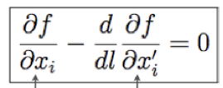
Snell’s Law
θ₂
n₂
0
nx’_{i}/[x’²+y’²+z’²]^{1/2}
θ₁
n₁
y=x/tan(θ)
n/[1+(dy/dx)²]^{1/2}=constant
Trig ID: 1/sin²(θ)=1+[1/tan²(θ)]
➔ n sin(θ)=constant
➔ n₁sin(θ₁)=n₂sin(θ₂)

Slide 4
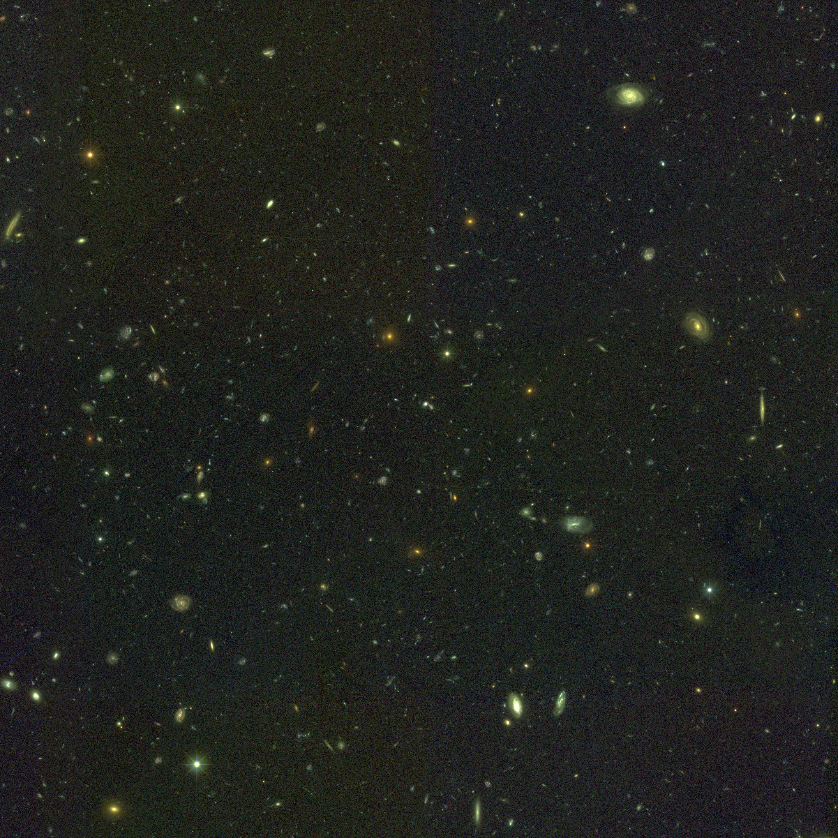
Plot credit: NASA/ESA
All we have to do is determine deflection angle
Tells us about the potential and gravity !
Already been done hundred years ago !
End of the story :) ? Next lecture…

Slide 5
What
do we
want to
measure
What
do we
measure
How
do we
measure
Why
do we
measure

Slide 6
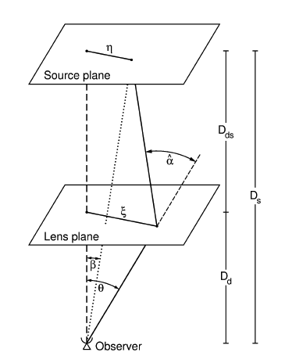
What is Gravitational Lensing?
Propagating photons follow geodesics in space
The geodesics are distorted from straight lines by the presence of massive objects
Plot credit: Bartelmann & Scnneider

Slide 7
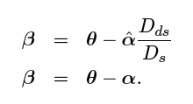
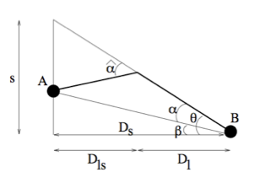
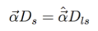
Geometry
The Born Approximation
For small angles
Plot credit: Bacon

Slide 8
The Lens Equation
Lens equation and define the terms
Relates True Position
to Observed Position
Plot credit: Bartelmann & Scnneider

Slide 9
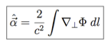
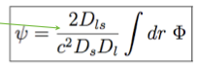
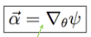
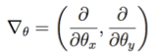
The Lensing Potential
From last lecture recall that deflection angle is related
to the gradient of the potential
Define the “Lensing potential” as a
projected, scaled potential
Allows us to write
Derivative on the sky

Slide 10
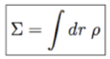
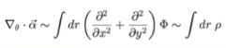
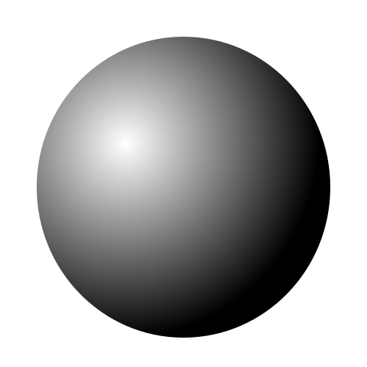
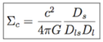
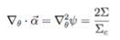
Surface Density
Convenient approximation of a lensing mass
Define the “critical density” as
Can define a 2D Poisson equation

Slide 11
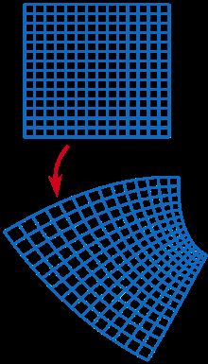
The Distortion Matrix
Go back to the lens equation
Every point is mapped to a new point via a shear mapping
Plot credit: Wikipedia

Slide 12
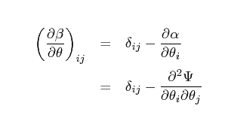
The Distortion Matrix
Write down the Jacobian of the coordinate transformation
Describes how unlensed point maps to lensed point
ψ=0 implies no mass and no lensing

Slide 13
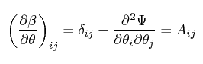
The Distortion Matrix
This defines the “Distortion Matrix” as
Four derivatives of the lensing potential corresponding the 2D on-sky coordinates
ψ₁₁, ψ₂₂, ψ₂₁, ψ₁₂

Slide 14
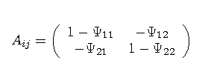
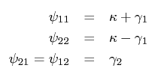
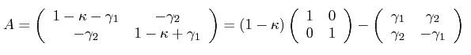
Shear γ and Convergence κ
Closer look at the Distortion matrix
Decompose into a trace and traceless part
Define

Slide 15
Shear γ and Convergence κ
What shape of distortion does this imply?

Slide 16
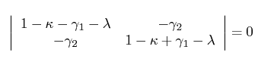
Disortion is Elliptical
For a general set of source positions X write the eigen equation
AX=λX
(A-λ)X=0
Characteristic equation : |A-λ1|=0
λ are the eigenvalues

Slide 17
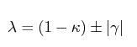
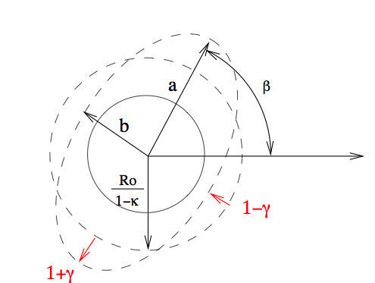
Disortion is Elliptical
Solving the determinant
κ

Slide 18
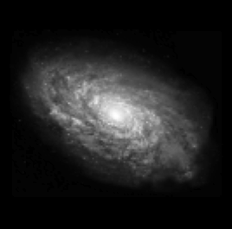
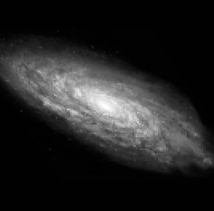
Distortion is elliptical
γ₁
γ₂
THE ADDITIONAL ELLIPTICITY IMPRINTED ON AN OBJECT IS CALLED SHEAR

Slide 19
What is ellipticity?
Specified by 3 numbers
Semi-Major axis
Semi-Minor
Angle
Many different
equations for an ellipse use
different parameterizations
and coordinate systems
a=Semi-Major Axis
ϑ
b=Semi-Minor Axis
Best to think of an ellipse as a compression/stretching of
the axes, followed by a rotation

Slide 20
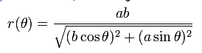
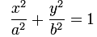
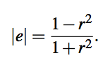
Disortion is Elliptical
Symmetric under rotations of 180 degrees
A_{new}=RA_{old}R^{T}
Exercise : show this is true
Distortion is elliptical
“Ellipticity” defined as note |e|< 1

Slide 21
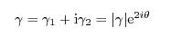
Complex Notation
Can write shear (or ellipticity) in complex form
Shear is a spin-weight 2 field
Symmetric under rotations of 180 deg.
Polarisation also an example of spin-2
Convergence is a spin-wight 0 field (symmetric under any rotation)
Spin 0 = scalar
Spin 1 = vector

Slide 22
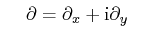
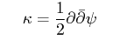
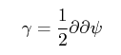
Raising and Lowering Operators
Shear as spin 2, Kappa as spin 0
ψ (lensing potential) is a scalar (spin-0) field
Define a complex derivative
A raising/lowering operator
+1 or -1 (when conjugate is applied)
Convergence and shear are now defined as

Slide 23
Recap
Lensing equation
Local mapping
General Relativity relates this to the gravitational potential
Distortion matrix implies that distortion is elliptical : shear and convergence
Simple formalise that relates the shear and convergence (observable) to the underlying gravitational potential

Slide 24
What is ellipticity?
Specified by 3 numbers
Semi-Major axis
Semi-Minor
Angle
Many different
equations for an ellipse use
different parameterizations
and coordinate systems
a=Semi-Major Axis
ϑ
b=Semi-Minor Axis
Best to think of an ellipse as a compression/stretching of
the axes, followed by a rotation

Slide 25
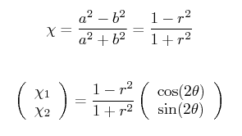
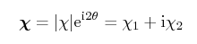
X₁
X₂
Create a single (complex) number “ellipticity”
Collapse the size information -> 2 numbers
Encodes orientation

Slide 26
How do we measure ellipticity?
Quote from night hike:
“I see Andromenda!”
“I think I’ve just measured it’s ellipticity!”

Slide 27
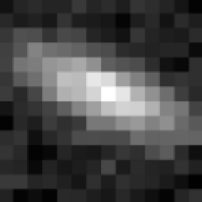
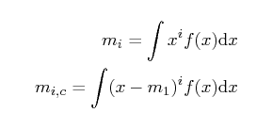
How to measure ellipticity?
Consider moments of a 1D distribution
0th Moment = ?
1st Moment = ?
2nd Moment = ?

Slide 28
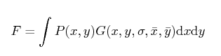
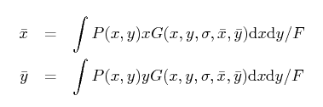
Moments of a 2D Function
Include a weight G
0th Moment
1st Moments
Mean x
Mean y

Slide 29
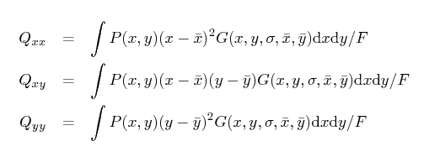
2nd Order Moments in 2D
Three 2nd order moments (recall that ellipticity needs 3 numbers)

Slide 30
How are Q related to ellipticity?
acosϑ
Note:
Q are variances (so squared quantities)
Homework… prove the Q_{xy}
a
asinϑ
ϑ
ϑ
b
bcosϑ
Contributions to the moments:
Q_{xx}=F(a²cos²ϑ+b²sin²ϑ)
Q_{yy}=F(a²sin²ϑ+b²cos²ϑ)
Q_{xy}=F(a²-b²)sinϑcosϑ
bsinϑ
Notes:
Maths on the board

Slide 31
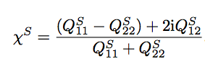
How are Q related to ellipticity?
Q_{xx}=F(a²cos²ϑ+b²sin²ϑ)
Q_{yy}=F(a²sin²ϑ+b²cos²ϑ)
Q_{xy}=F(a²-b²)sinϑcosϑ
Now take combinations:
Q_{xx}+Q_{yy}=F(a²+b²)
Q_{xx}-Q_{yy} =F(a²-b²)cos2ϑ
2Q_{xy} =F(a²-b²)sin2ϑ
Notes:
Note that the subscript S has been used….

Slide 32
χ₂
x
|
+
χ₁
|

Slide 33
Intrinsic Ellipticity
Have introduced here the notion that the sources themselves are already elliptical
“Shear” is an additional ellipticity imprinted by lensing
How to related observed ellipticity to shear?
g₁
g₂

Slide 34
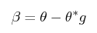
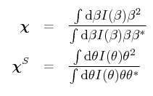
How to relate ellipticity to shear
How to source moments transform/change under the influence of the lens equation?
Substitute lens equation into image plane moments
Rearrange (hint: multiply numerator and denominator by source plane denominator)
Recall 2Re(z)=z*+z for a complex number
Image plane
Source plane

Slide 35
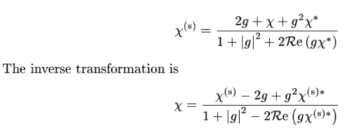
Schneider & Seitz (1995)
Allows the observed ellipticity (moments) to be related to the intrinsic (unlensed) ellipticity and shear
Exercise : Show that this is the way χ transforms under shear

Slide 36
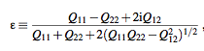
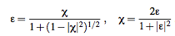
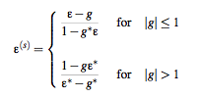
Bonnet & Mellier (1995)
Different normalisation of the moments
More complicate denominator, better shear relation

Slide 37
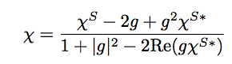
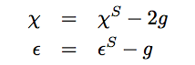
The weak lensing limit
Only linear in shear

Slide 38
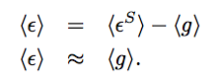
The Weak Lensing Assumption
When we average over (enough) galaxies in the universe the intrinsic ellipticity is randomly orientated such that
KEY WEAK LENSING RESULT
RELATES
OBSERVABLE (MOMENTS) to
PHYSICS (LENS EQUATION) and SHEAR

Slide 39

But… over large enough scales (and assuming isotropy) shear averages to zero
But variance of the shear is related to the matter power spectrum
Lensing potential related to Newtonian potential
Correlation of perturbations -> Power spectrum

Slide 40
e_{observed} = e_{intrinsic} + γ
<e_{observed}e_{observed}> = <e_{intrinsic}e_{intrinsic}> +
<γe_{intrinsic}> + <e_{intrinsic}γ> +
<γγ>
II
GI
If galaxies are randomly aligned need many galaxies to reduce the shot noise term

Slide 41


Intrinsic Alignments
But… what if the intrinsic orientations are not random?

Slide 42
There is nothing new to be discovered in physics now, All that remains is more and more precise measurement.
Kelvin
Plot credit: ESA/NASA
All we have to do is measure ellipticity of the galaxies
Average over a sufficient number
Tells us about the local potential
Easy :) ? Next lecture…

Slide 43

Homework
Exercise for next lecture
Derive the χ relation between shear and unlensed ellipticity
Hint: use moments
“Extra credit” derive the probability distribution of χ
Hint: use quotient distribution and assume Gaussian moments
Hint: not a trivial calculation… (may need mathematica at some point)

